Slide 1
Turkey

Slide 2
TURKEY WORLD LOCATION
Turkey
TURKEY

Slide 3
Brief Background on Türkiye
Türkiye, officially known as the Republic of Türkiye, lies in the geographical gap separating the European and Asian continents. It is bordered by countries including Greece, Bulgaria, Syria, Iraq, and Iran, and surrounded by seas including the Mediterranean, Aegean, and Black seas.
Türkiye has an approximate population of more than 85 million inhabitants. The capital of the country is Ankara, and its largest city is Istanbul. The main language spoken in Türkiye is Turkish, and its culture reflects elements of the Ottoman Empire, Middle Eastern, Central Asian, and European culture.
Türkiye’s geography ranges from mountainous areas to forested lands and dry lands, including coasts. Agriculture, tourism, industry, and trade are some of the main components of the economy of Türkiye.

Slide 5
AWESOME WORDS

Slide 6
—SOMEONE FAMOUS
“This is a quote, words full of wisdom that someone important said and can make the reader get inspired.”

Slide 7
9h 55m 23s
333,000
386,000 km
Jupiter's rotation period
The Sun’s mass compared to Earth’s
Distance between Earth and the Moon

Slide 8
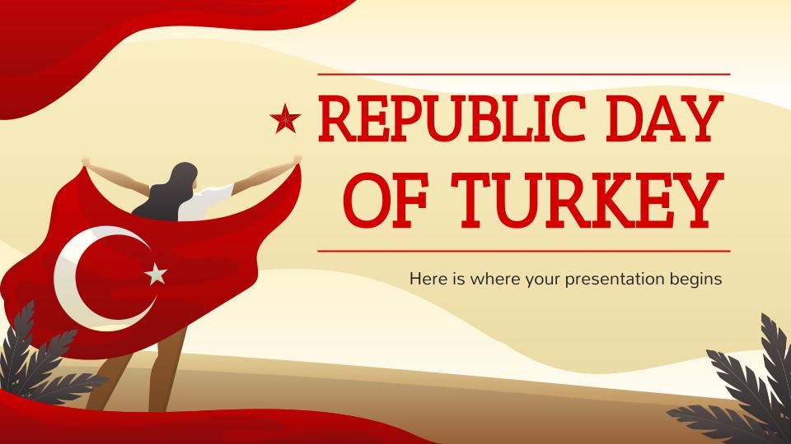
MOCKUP
You can replace the image on the screen with your own work. Just right-click on it and select “Replace image”

Slide 9
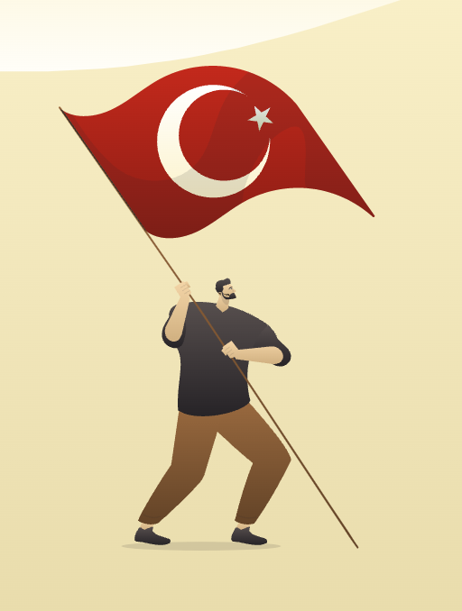
TABLET APP
You can replace the image on the screen with your own work. Just right-click on it and select “Replace image”

Slide 10
TURKEY CITIES
ANKARA
Earth is the only planet with life and the one where we all live on
Istanbul
Ankara
ISTANBUL
Karakose
Venus has a beautiful name and very high temperatures
KARAKOSE
Mercury is the closest planet to the Sun and it’s very small

Slide 11
HISTORY OF TURKEY
2019
2020
2021
2022
Mercury is very close to the Sun
Saturn is a gas giant and has several rings
Mars is full of iron oxide dust
Jupiter is the biggest planet

Slide 12
THANKS!
Please keep this slide for attribution

Slide 13
ICON PACK

Slide 14
ALTERNATIVE RESOURCES
Here’s an assortment of alternative resources within the same style of this template:
Gradient 15 temmuz background with hands holding flags
Gradient 15 temmuz illustration with people holding flag

Slide 15
Slide 1 — Introduction to Türkiye
Wikipedia – Türkiye
Britannica – Turkey Facts & Geography

